Slide 1

ATLIQ HOSPITALITY ANALYSIS
BY
NAGARJUN PATIMI

Slide 2
PROBLEM STATEMENT
Atliq Grands owns multiple five-star hotels across India.
They have been in the hospitality industry for the past 20 years.
Due to strategic moves from other competitors and ineffective decision-making in management, Atliq Grands are losing its market share and revenue in the luxury/business hotels category.
As a strategic move, the managing director of Atliq Grands wanted to incorporate “Business and Data Intelligence” in order to regain their market share and revenue.

Slide 3
DATASETS
It consists of 3 months booking details of all the atliq hotels.
Dataset contains 5 excel files.
Dim_date
Dim_hotels
Dim_rooms
Fact_aggregated_bookings
Fact_bookings
Metric list excel file
Meta_data_hospitality text document.

Slide 4
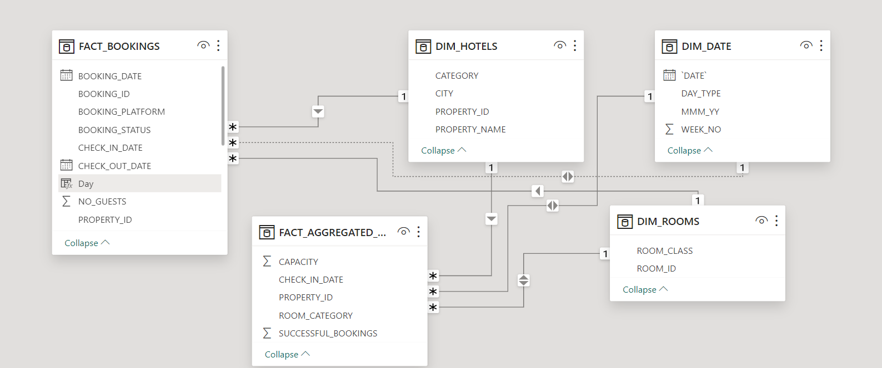
Data model

Slide 5
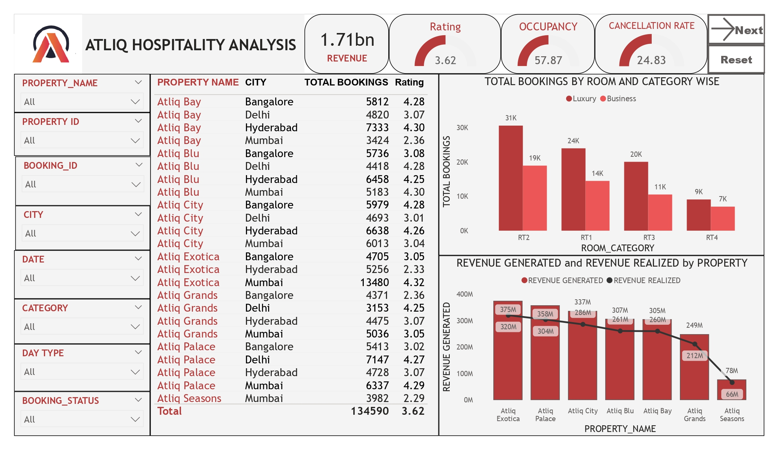
Dashboard

Slide 6
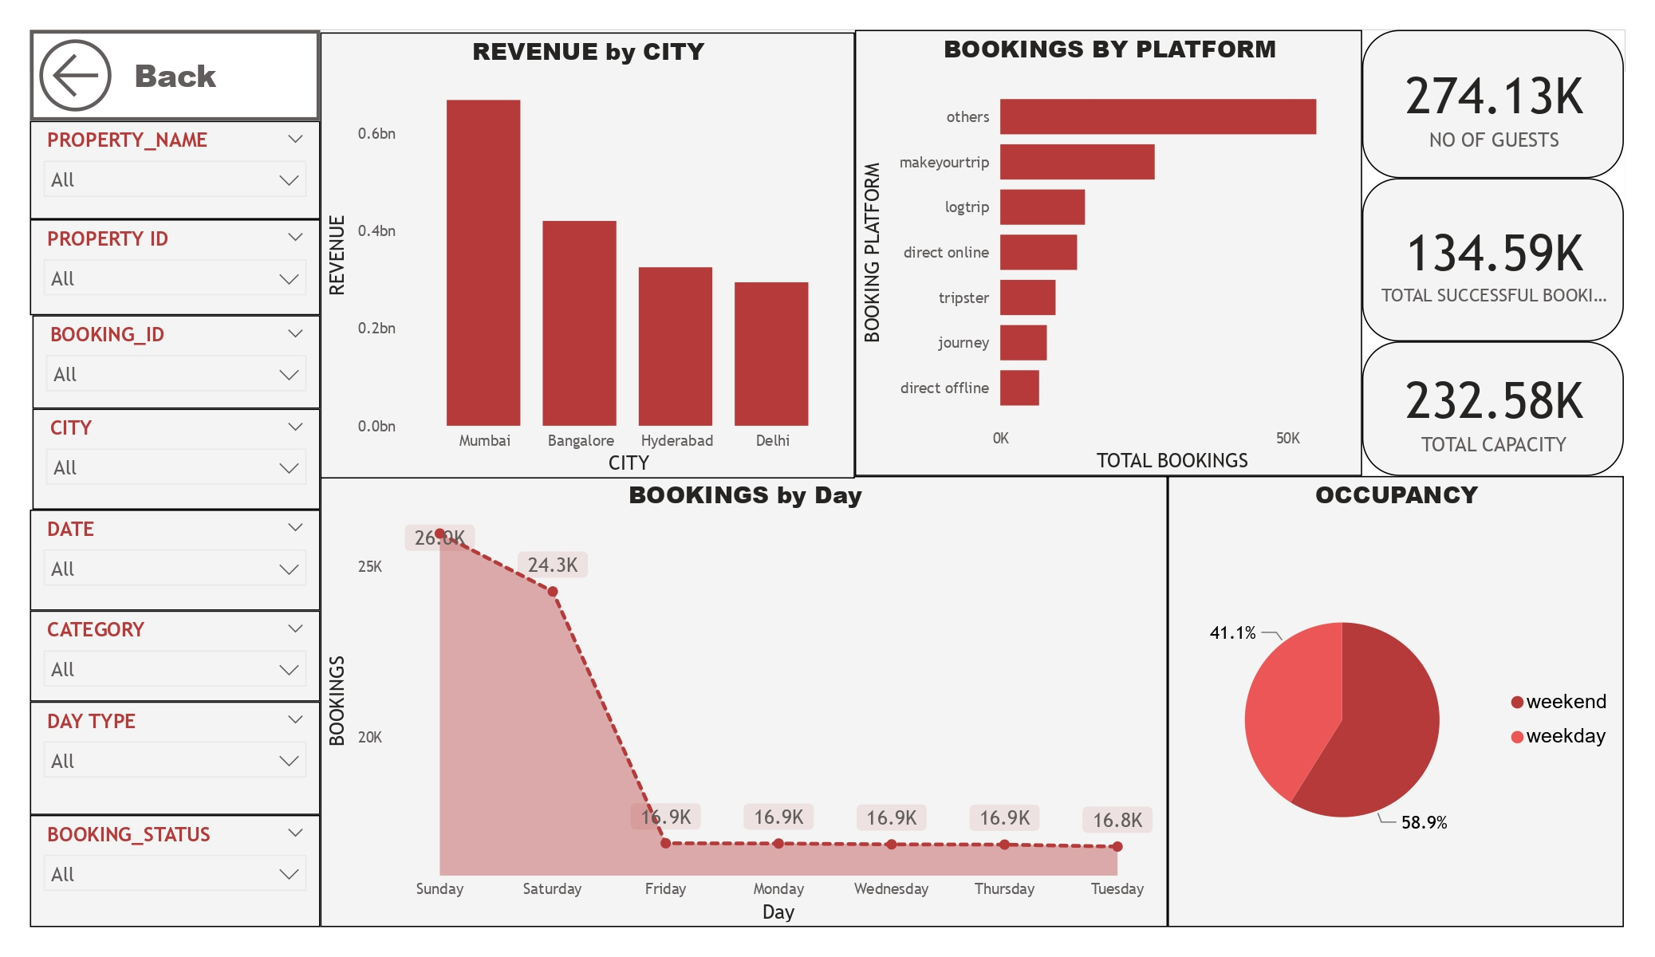
Dashboard

Slide 7
INSIGHTS
Mumbai generates the highest revenue (669 M) followed by Bangalore, Hyderabad and Delhi
AtliQ Exotica generates highest revenue compared to all 7 type of properties with 375 Million revenue, rating 3.62, occupancy percentage 57.26 and cancellation rate as 24.4%.
AtliQ Blu has the highest occupancy of 62.02%.
Sunday recorded the highest bookings among all, which is 26k.
Delhi tops both in occupancy and rating followed by Hyderabad, Mumbai, Bangalore.
AtliQ lost around 200 Million in cancellation.
Luxury type rooms has the most booking and as well higher cancellation rate
Bookings are mostly done by others booking platforms.
Occupancy on weekends is 58.9% and 41.1% in weekdays.
RT2 room types are mostly booked followed by RT1, RT3 and RT4.

Slide 8
THANK YOU

